Slide 1


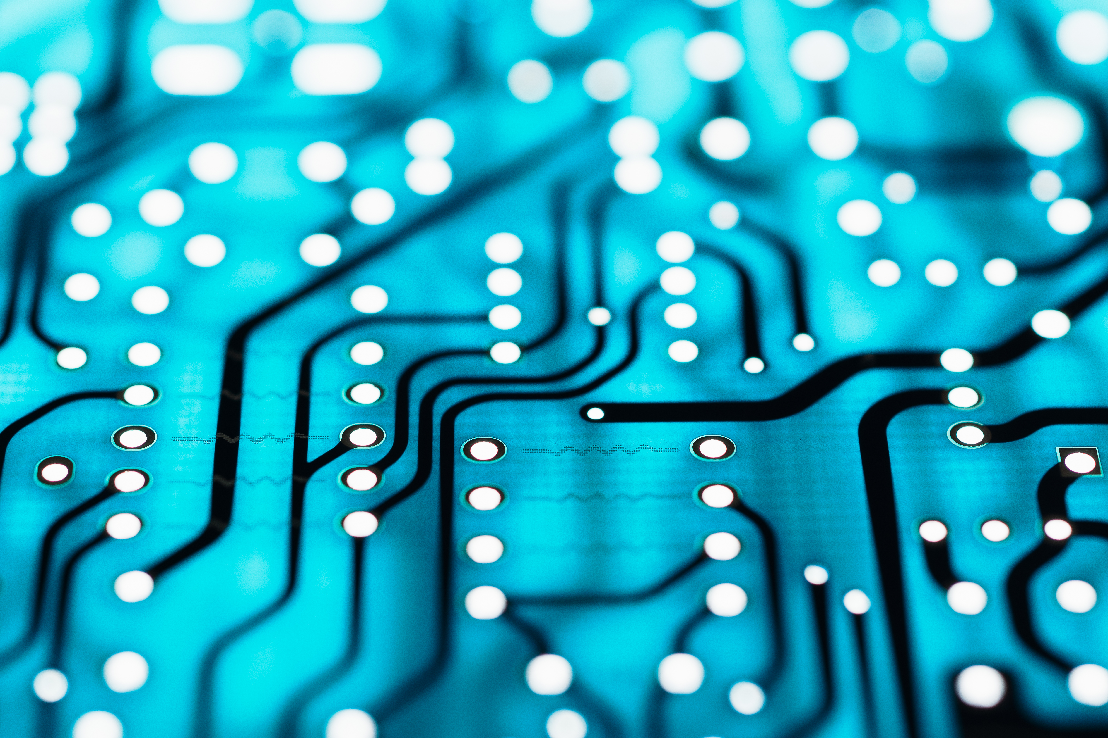
Machine Diagnosis
Team mates:
1.V sudharshan reddy (urk22cs7062)
2.Anson saju George (urk22cs7064)
3.Esther alice mathew (urk22cs7102)
4.Sweetlin jeba (urk22cs7037)

Slide 2
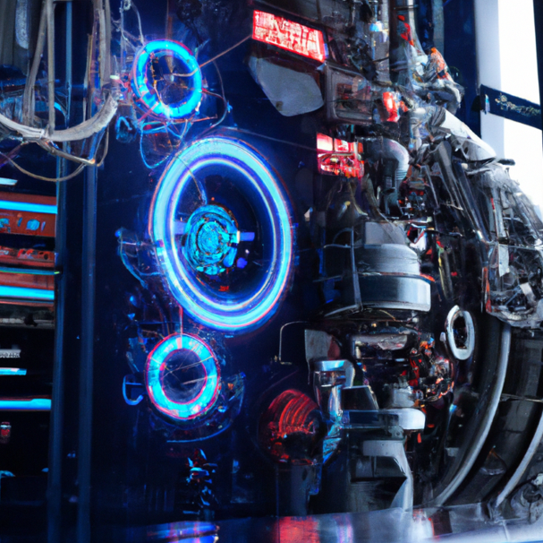
Introduction:
Machine diagnosis is the process of identifying and analyzing problems in machinery through various methods.
It involves using sensors, software, and other tools to collect data and analyze it to determine the root cause of any issues

Slide 3

Types of Machine Diagnosis
There are several types of machine diagnosis, including vibration analysis, oil analysis, and thermography. Vibration analysis involves measuring the vibration of a machine to identify any abnormalities, while oil analysis examines the condition of the lubricant in a machine to detect wear or contamination.

Slide 4
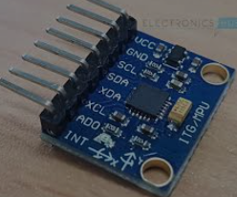
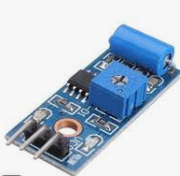
COMPONENTS USED:
1.MPU-6050 (Accelerometer & Gyroscope): The MPU-6050 is a 6-axis motion tracking device that combines an accelerometer and gyroscope, used for orientation and motion sensing in robotics and electronic devices.
2.Vibration sensor:
A vibration sensor detects and measures vibrations in a system or machine, and is commonly used in condition monitoring, predictive maintenance, and structural health monitoring.

Slide 5
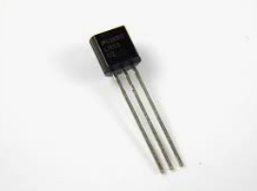
3.LM-35 (Temperature sensor) LM-35 is a precision temperature sensor that produces a voltage output proportional to Celsius temperature. It is commonly used in temperature measurement and control applications such as thermostats, environmental monitoring, and industrial automation.

Slide 6
Working
Machines have become an integral part in every aspect of human life. Which entails perpetual perusal of the contraption. The last few years have shown a tremendous inflation in the domain of machine diagnostics, alternatively, fault diagnostics. Machine diagnosis has its significance in resolving the conditions of different machine parts for determining various mechanical failures.
The proposed system is an IoT- based solution to monitor the conditions of an industrial device.
Our goal is to implement a device that is used at the manufacturing stage of the product, not only then but also when the device is in the hands of the customer. Our device will help monitor the condition and health of the product while manufacturing. It will ensure that the product works in the way the manufacturer intended it to. It also, in turn, guarantees a smooth user experience.

Slide 7
Schematic diagram

Slide 8

Benefits of Machine Diagnosis:
Machine diagnosis can help prevent costly downtime and repairs by detecting issues before they become major problems.
It can also improve equipment reliability and extend the lifespan of machinery, ultimately saving companies time and money.

Slide 9
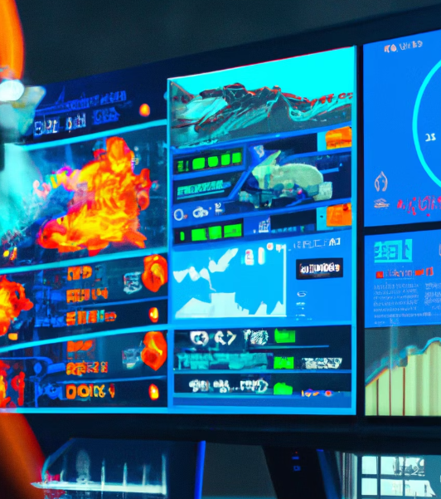
Challenges of Machine Diagnosis:
One of the main challenges of machine diagnosis is collecting accurate and reliable data from sensors and other tools.
Another challenge is interpreting and analyzing the data effectively to identify the root cause of any issues.

Slide 10

Future of Machine Diagnosis:
Advances in technology, such as artificial intelligence and machine learning, are expected to revolutionize machine diagnosis.
These tools will enable machines to learn and adapt to their environments, making it easier to detect and diagnose issues in real-time.

Slide 11

Conclusion:
Machine diagnosis is a critical process for ensuring the reliability and longevity of machinery.
While there are challenges to overcome, advances in technology offer exciting opportunities for improving the accuracy and efficiency of machine diagnosis in the future.

